Slide 1
CardShark
Take the Edge Back
Canon Ellis, Eric Miao, Joshua Sylvester
Notes:
Welcome and today we are going to take the edge back with the cardshark app my name is joshua sylvester, along with eric miao and canon ellis.
Now before we get started I would like to make a disclaimer that this app or any technology like it, should never be used in a real casino or at real blackjack game.
Now with that said let’s talk about gambling

Slide 2
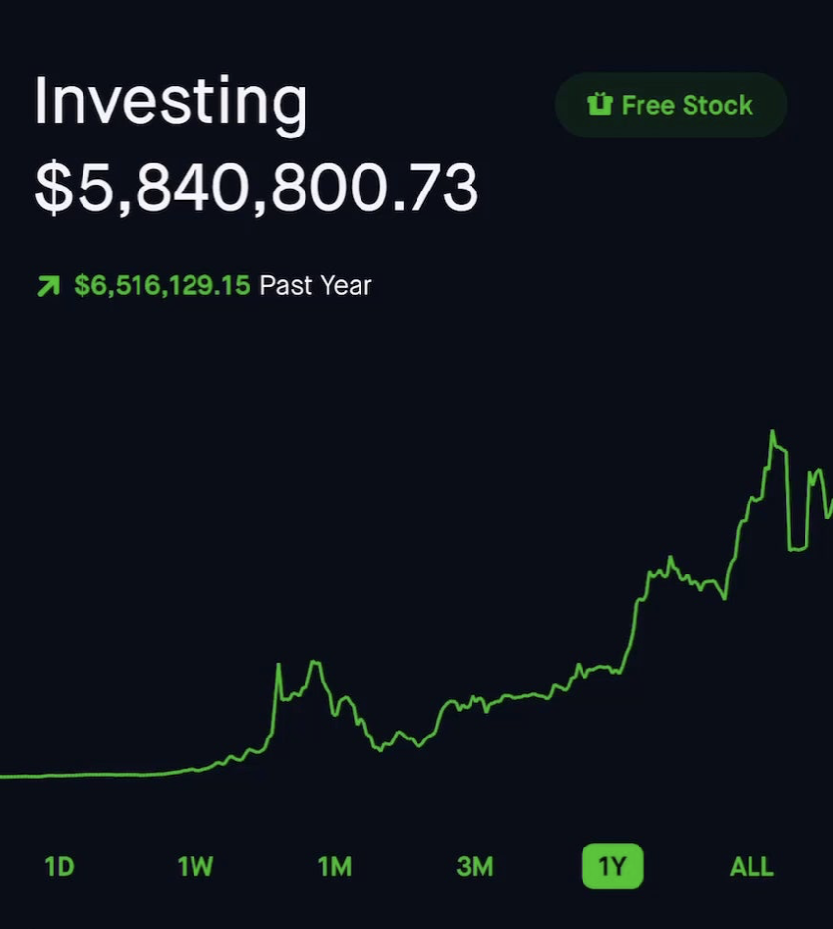
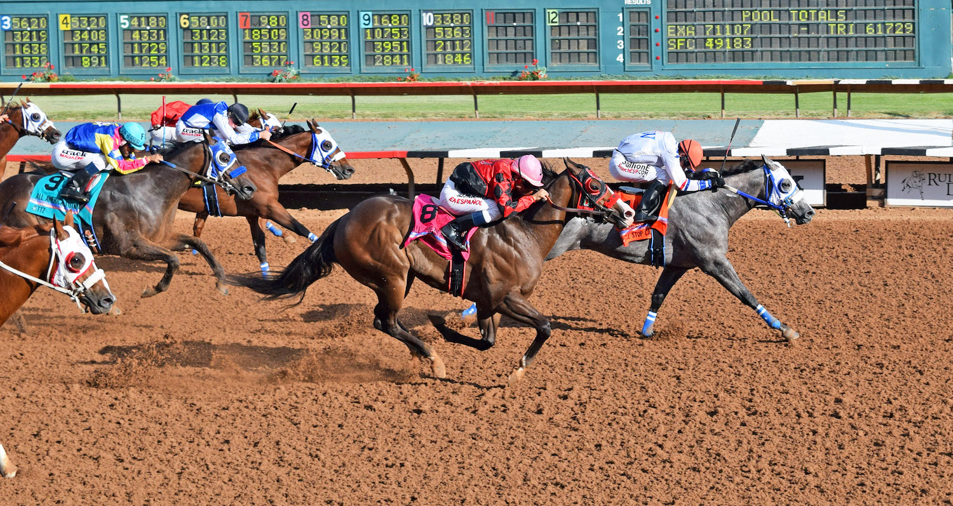

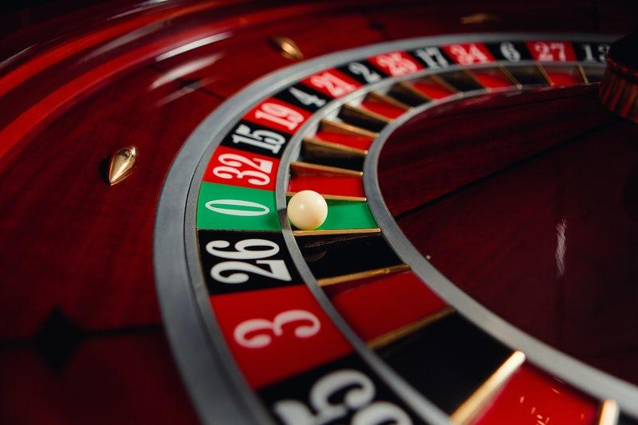
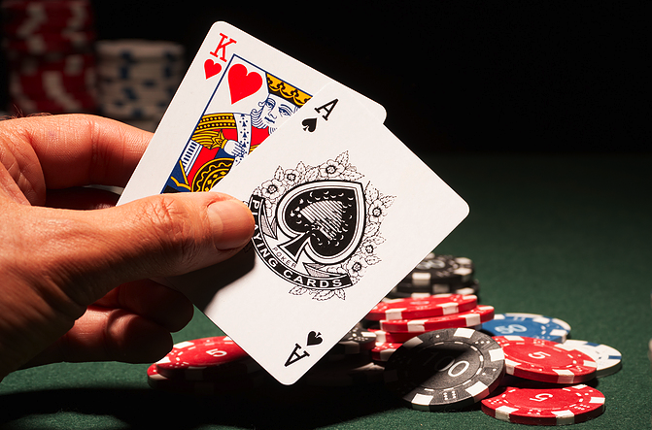
Notes:
Everyone likes gambling, whether it be on gamestop like a true wall street bets degenerate, or old school gambling on things like horseraces or fights. Then you’ve got the casino gambler cause after all who does like to spin the wheel or hit that sweet sweet Blackjack.
// But at the end of day, gambling is just that, gambling. Or is it?
https://external-preview.redd.it/WyqwgqsKmC7LukWD1g-McCmnVVq9KYpRHlrudzCLBNM.png?format=pjpg&auto=webp&s=744f113d4f7d5a9fe698886fb43b2719e44157c1
https://www.visitruidoso.com/wp-content/uploads/2021/03/10-WHISTLE-STOP-CAFE-copy.jpg
https://crescent.edu/uploads/editor/images/Blackjack.png
https://edge.twinspires.com/casino-news/roulette-table-layout-explained-3-different-types-of-roulette/

Slide 3
The House Always Wins
Notes:
And show of hands how many of you have heard this before?
And the reason they say this, is cause statistically it’s true

Slide 4
BLACKJACK
Your Edge
Basic Strategy
-0.5%
Your Edge
Basic Strategy + Card Counting
+1.0%
Notes:
Blackjack typically has a house edge of around half a percent on average
But with counting cards you can take that edge back.

Slide 5
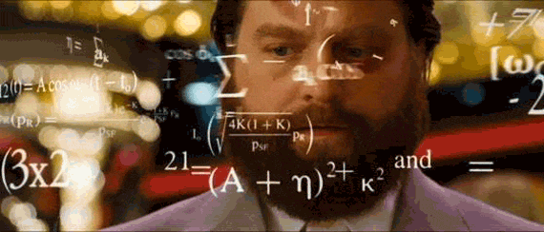
Notes:
But Card Counting is hard right? Unless your rainman or an MIT student you don’t have chance.

Slide 6
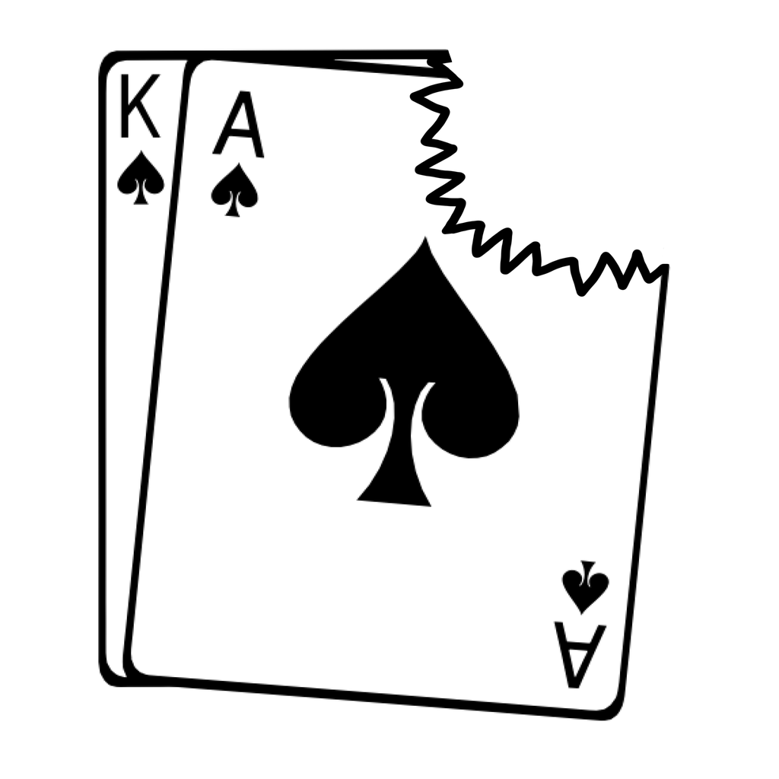
CardShark
Take The Edge Back
Notes:
So that’s why we created the Cardshark App that uses state of the art machine learning to classify and count the cards for you

Slide 7
Card Counting (Hi-Lo)
Face | Value
2 - 6 | +1
7 - 9 | 0
10 - A | -1
Notes:
https://wizardofodds.com/games/blackjack/card-counting/high-low/

Slide 8
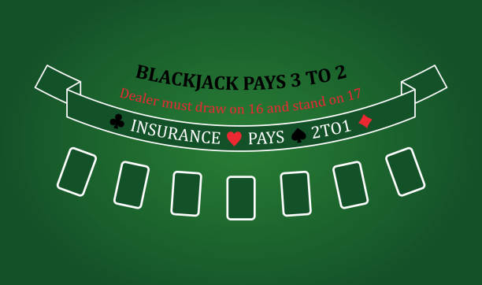
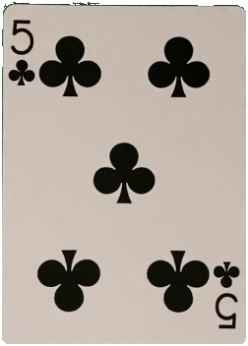
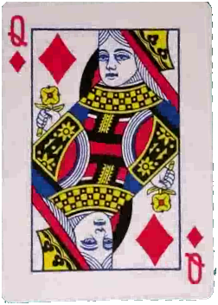
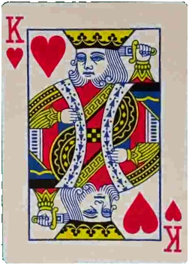

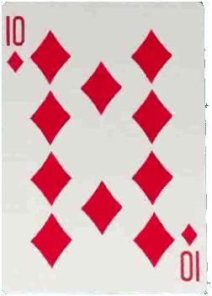
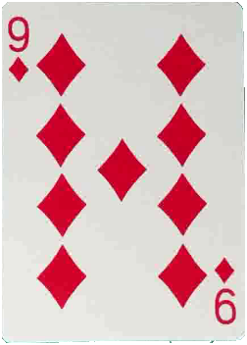
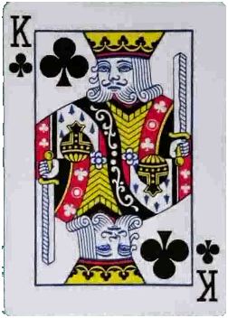
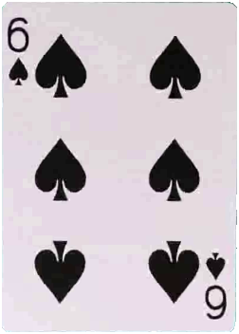
Card Counting
+10
+9
+8
+1
0
-1
-2
+1
Notes:
So that’s why we created the Cardshark App that uses state of the art machine learning to classify and count the cards for you

Slide 9
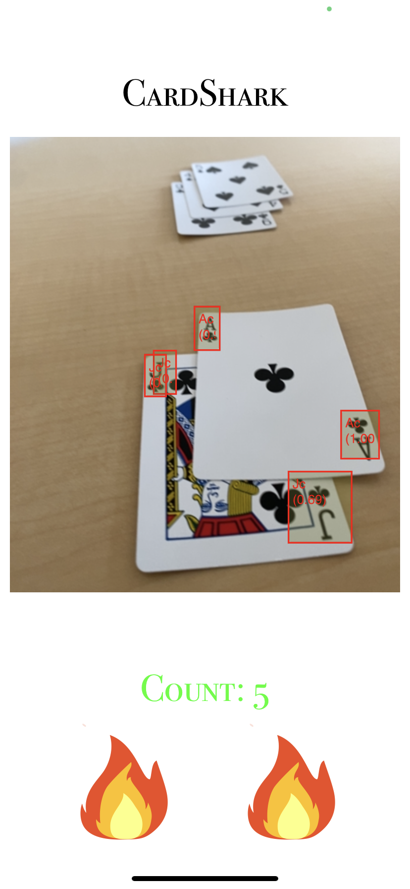

CardShark
Notes:
We leveraged turicreate to create an application which tracks cards on the table and keeps the count for you
When we started this project I was working at a startup company where we did a lot of image classification on social media content so I knew we were going to want to do a yolo implementation of sorts for this real time video problem
But we needed a dataset for training
https://medium.com/kinandcartacreated/intro-to-machine-learning-on-ios-with-createml-turicreate-part-2-f30f94fe8172

Slide 10
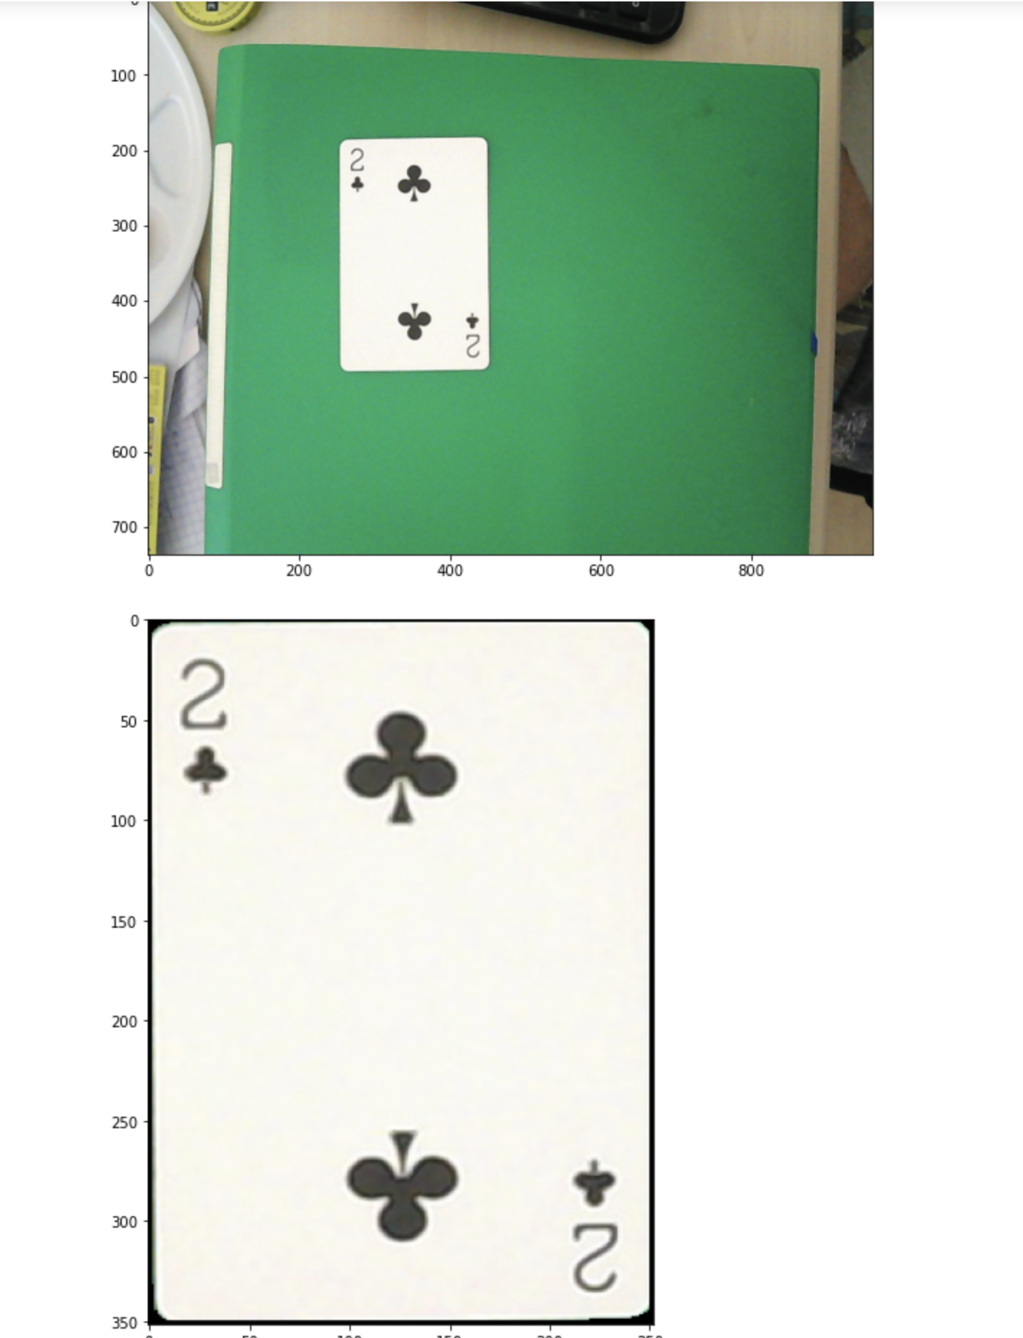
Dataset Generation
Take videos each card
Use OpenCV to extract cards from each frame
https://cs.brown.edu/research/pubs/theses/capstones/2020/xu.philip.pdf
Notes:
When we started this project I was working at a startup company where we did a lot of image classification on social media content so I knew we were going to want to do a yolo implementation of sorts for this real time video problem
But we needed a dataset for training

Slide 11
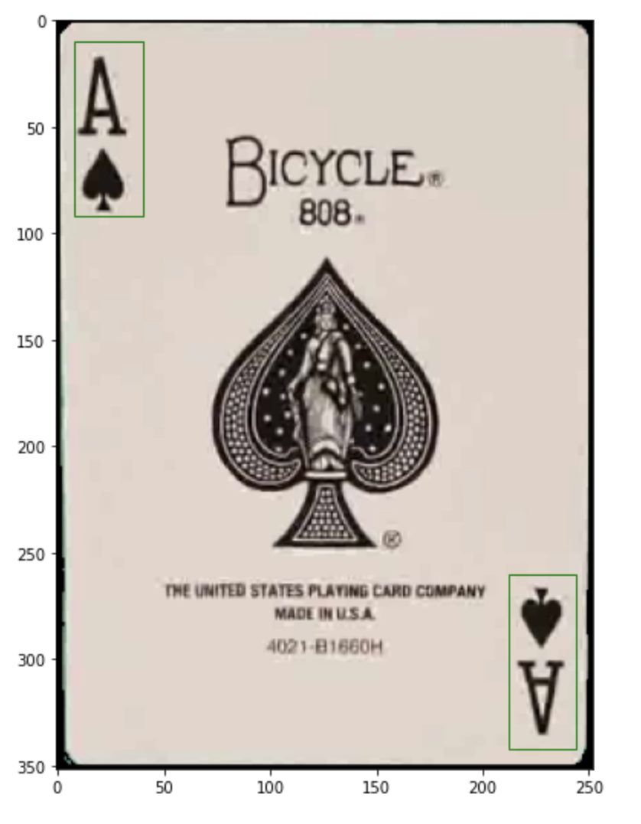
Dataset Generation
3) Use preset measurements to
bounding box the value and
suit
https://cs.brown.edu/research/pubs/theses/capstones/2020/xu.philip.pdf
Notes:
Take several videos
Break the videos down frame by frame
Use opencv to extract the card from the video
Use some hardcoded measurements to isolate the number and suit
Use opencv to constrain the bounding box around the shape of the suit and top of number
Generated a dataset of images with a variety of backgrounds

Slide 12
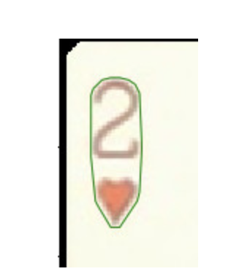
Dataset Generation
4) Use OpenCV to constrain the
bounding box around the
number and suit
https://cs.brown.edu/research/pubs/theses/capstones/2020/xu.philip.pdf
Notes:
Take several videos
Break the videos down frame by frame
Use opencv to extract the card from the video
Use some hardcoded measurements to isolate the number and suit
Use opencv to constrain the bounding box around the shape of the suit and top of number
Generated a dataset of images with a variety of backgrounds

Slide 13
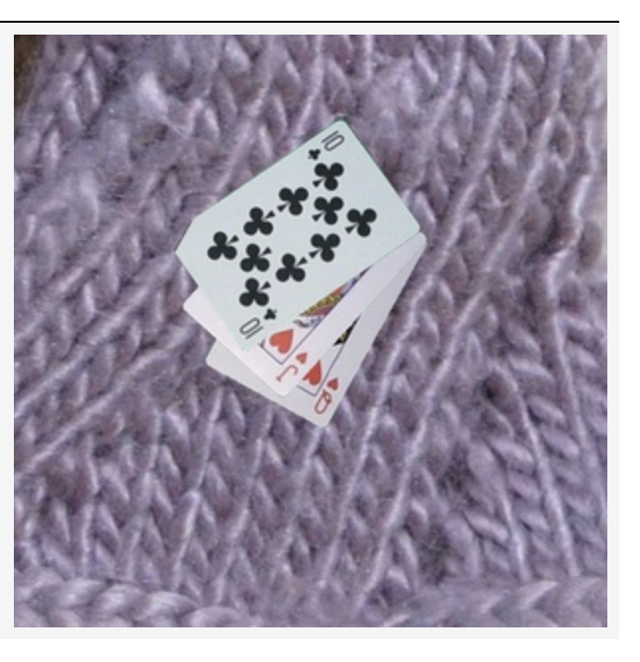
Dataset Generation
5) Generate an artificial dataset of
1000 images from these cards
using a variety of backgrounds
and data augmentation
https://cs.brown.edu/research/pubs/theses/capstones/2020/xu.philip.pdf
Notes:
Take several videos
Break the videos down frame by frame
Use opencv to extract the card from the video
Use some hardcoded measurements to isolate the number and suit
Use opencv to constrain the bounding box around the shape of the suit and top of number
Generated a dataset of images with a variety of backgrounds

Slide 14
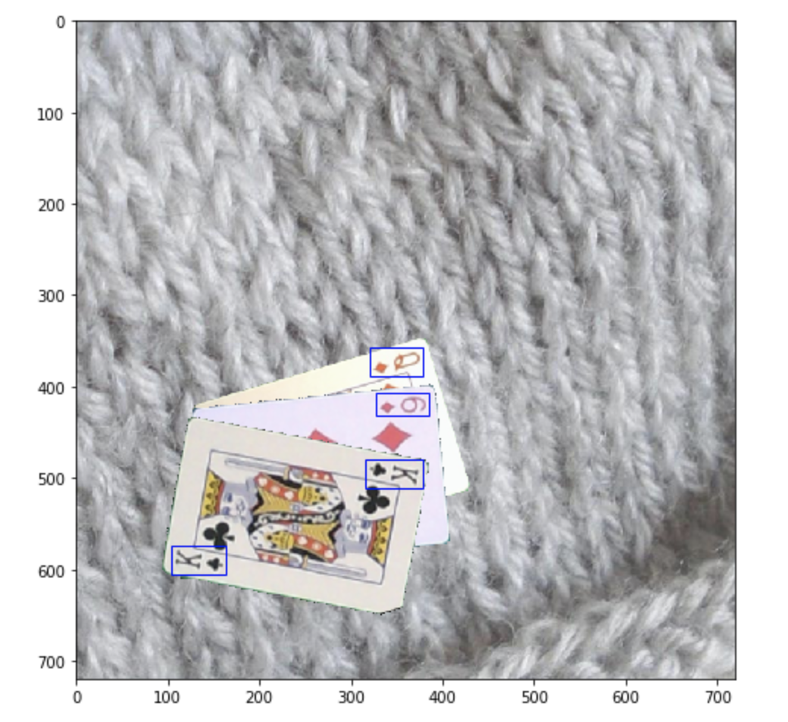
Dataset Generation
6) Add bounding boxes using convex hulls
https://cs.brown.edu/research/pubs/theses/capstones/2020/xu.philip.pdf
Notes:
We treated it like a black box

Slide 15

Model Generation
Notes:
We treated it like a black box

Slide 16
Putting It All Together
Hi-Lo Counting System
Constraints:
Only 1 Deck
Each card needs to be seen for 30 frames
Once a card’s seen, it can’t be counted again
Notes:
https://wizardofodds.com/games/blackjack/card-counting/high-low/

Slide 17
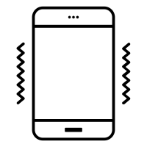
Incognito Mode
The phone goes dark
The count will be vibrated to you in bursts using Haptic
+: series of short bursts
-: Long burst followed by short bursts
Notes:
https://thenounproject.com/icon/cell-phone-vibrating-1913175/

Slide 18
Demo

Slide 19
?
Questions

